Slide 1

Advanced Fuzzing Topics
Offensive Computer Security
FSU CS Dept
Spring 2014

Slide 2

Outline
Taint analysis
Dynamic Taint Analysis
Code Paths
Symbolic representations
Advancements

Slide 3
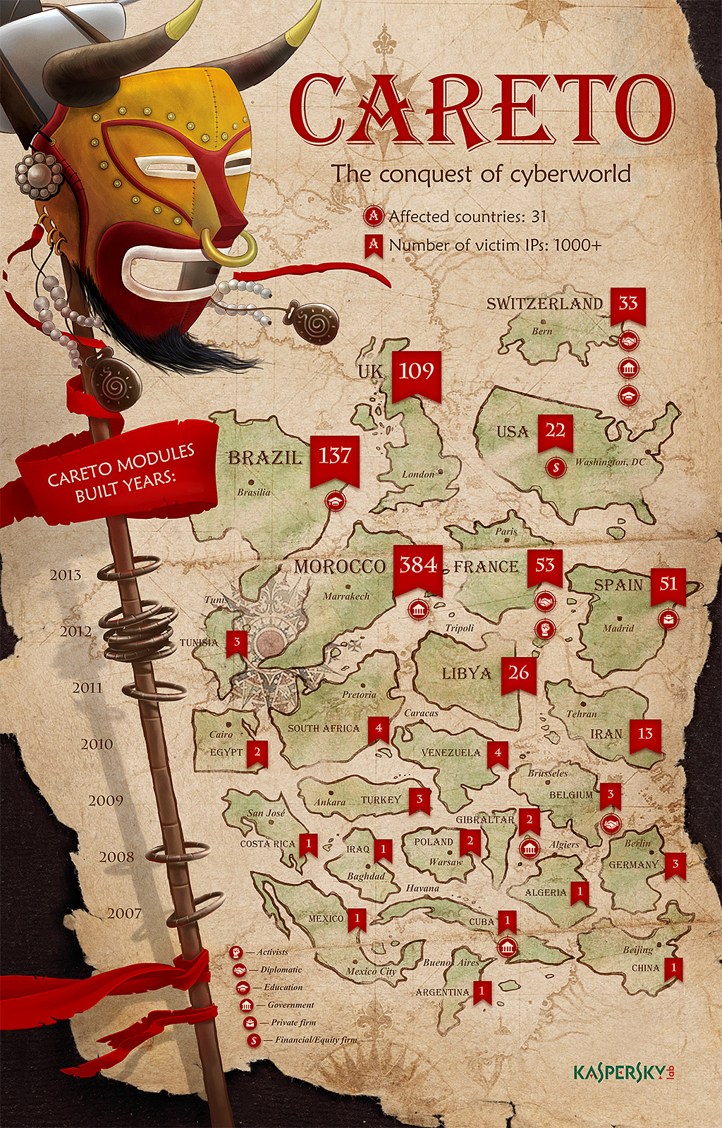
“THE MASK” APT
attacked Kaspersky AV to privilege escalation & hide
importance of finding vulns in own product
http://www.securelist.com/en/downloads/vlpdfs/unveilingthemask_v1.0.pdf

Slide 4
Crash Analysis /
Taint Analysis
Once crashes are caused, determining if a vulnerability exists

Slide 5
Exploitability Analysis
Determine the exploitability of bugs.
No accurate tools exist for vuln analysis.
!exploitable (http://msecdbg.codeplex.com/)
is a WinDBG extension
reports what is definately exploitable, probably exploitable, not exploitable, and unknown
but is considered not very accurate.
mona.py has an exploit generation feature that is useful for getting started

Slide 6
Taint Analysis
Goal is to mark data originating from untrusted sources as tainted
can be done statically / dynamically
Two dependencies that determine taint:
Data flow dependencies
Control flow dependencies

Slide 7
Taint Tracking Policies
Just track control flow dependencies?
Also data flow dependencies?
Track taint after free() / garbage collection?
miss use after free or use uninitialized vulns.
bytewise?
or even bitwise?

Slide 8
Taint Analysis
System
User Input
STACK
CPU
?
Shared Libraries
REGISTERS
HEAP
HD / RAM
Data
text

Slide 9
Taint Analysis
EIP?
EDI?
...
System
User Input
STACK
CPU
?
Shared Libraries
REGISTERS
HEAP
HD / RAM
Data
text

Slide 10
Taint Analysis
Partial writes / Full writes
operations like shifts, and, nand, ...
ones that destroy information
Stop tracking taint when
variable overwritten by static /const value
var assigned from untainted object

Slide 11
Simple Taint Analysis
User inputs are non-repeating patterns:
Aa0Aa1Aa2Aa3Aa4Aa5Aa6Aa7Aa8Aa9Ab0Ab1Ab2Ab3Ab4Ab5Ab6Ab7Ab8Ab9Ac0Ac1Ac2Ac3Ac4Ac5Ac6Ac7Ac8Ac9Ad0Ad1Ad2Ad3Ad4Ad5Ad6Ad7Ad8Ad9Ae0Ae1Ae2Ae3Ae4Ae5Ae6Ae7Ae8Ae9Af0Af1Af2Af3Af4Af5Af6Af7Af8Af9Ag0Ag1Ag2Ag3Ag4Ag5...

Slide 12
Simple Taint Analysis
Check if registers at crash contain any of these patterns(ENDIANNESS MATTERS HERE!)
EIP = 5Af6 (big endian) f65A (little endian)
RIP = Ag1Ag2Ag (big endian) Agg21AAg (little endian (x86))
If confused, see (http://en.wikipedia.org/wiki/Endianness)

Slide 13
Problem
Patterns won’t work in all applications
method fails on any transforms of user input
encoding / decoding / expansion /etc…
This is a dumb approach, but effective.

Slide 14
Data flow dependencies
//x is tainted
y = 2;
z = x + y;
//z is tainted
From: http://diyhpl.us/~bryan/papers2/paperbot/e15bb28f0dc692c053f64bb48b879ab3.pdf

Slide 15
Control flow dependencies
//x is tainted
if (x > 1) y = 1 else y =2;
//y is tainted b/c influenced by x
From: http://diyhpl.us/~bryan/papers2/paperbot/e15bb28f0dc692c053f64bb48b879ab3.pdf

Slide 16
Taint Analysis
System
HELLO WORLD
STACK
CPU
?
Shared Libraries
REGISTERS
HEAP
Data
text
d14a028c2a3a2bc9476102bb288234c415a2b01f828ea62ac5b3e42f

Slide 17
Taint Analysis (For Differential Cryptanalysis)
System
HELLX WORLD
STACK
CPU
Throwing patterns here doesn’t work.
How would we pull this off?
?
Shared Libraries
REGISTERS
HEAP
Data
text
d14a028c2a3a2bc9476102bb288234c415a2b01f828ea62ac5b3e42f

Slide 18
Dynamic Taint Analysis (DTA)

Slide 19
DTA steps
1) Tag data originating from an unsafe source as tainted
2) track tainted data during execution
3) identify and prevent unsafe usage of tainted data.
REMEMBER THESE

Slide 20
DTA
Usually requires fine-grained control of the system
QEMU (emulator)
Debuggers
etc…

Slide 21
DTA Uses
Bug hunting
Detecting 0-days
Argos http://www.few.vu.nl/argos/?page=1

Slide 22
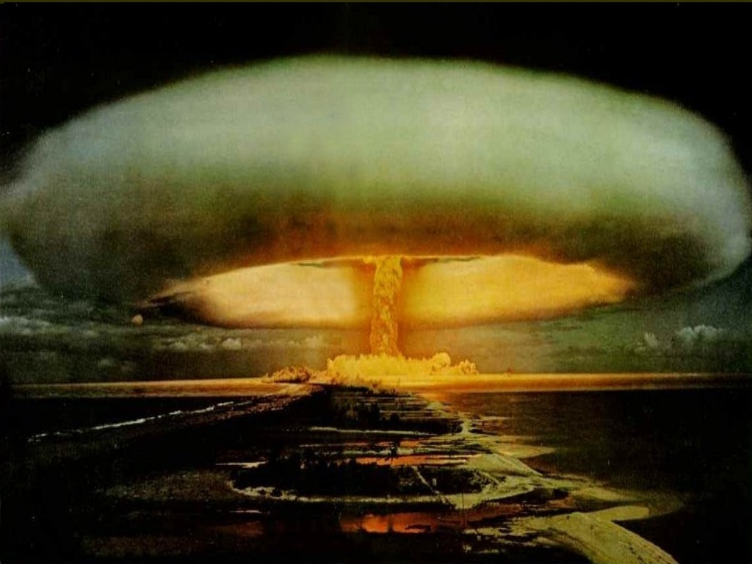
Code Paths
and avoiding explosions

Slide 23
Dynamic Analysis Problems
Code Coverage
Symbolic representation & Path Explosion
Differential fuzzing

Slide 24
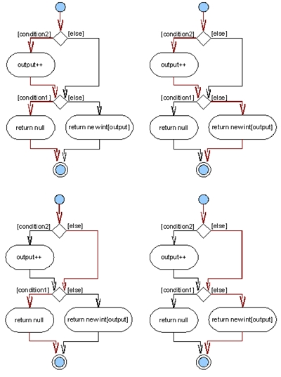
Code Coverage
Cover interesting Paths
Branches are expensive
imposes exponential cost
avoiding loops
avoiding already covered paths
required careful optimization
++Reasoning about code

Slide 25
https://github.com/elvanderb/TCP-32764

Slide 26
Code paths and reality
90% of execution time is spent in loops
Tons of optimization research done here
This alone is the subject of many PhD dissertations
branch prediction
A vulnerable code path might be traveled < 0.1% of the time on average.

Slide 27
Symbolic Representation / Constraints
if (x > 0 && x < 1600)
// does testing 1,2,3,4,..1598,1599.. matter?

Slide 28
Basic Symbolic Representation
Variables are represented by symbols
allow symbols to take any value
replace concrete operations with operations that manipulate symbolic values
special focus on branches
branches go one of two ways

Slide 29
Basic Symbolic Representation
When program branches on a symbolic value:
system follows both branches at once
keeps track of “path constraint” that determines the branch behavior
When a code path ends / bug is found:
test case can be quickly generated by solving all of the path constraints!
constraint solvers

Slide 30
Basic Symbolic Representation
Problems:
-Scales poorly
-high number of branches = explosion of code paths
Basic solutions to these ^
+parallel
+heuristics

Slide 31
Intermediate Representations (IR/IL)
A frontend (language) that facilitates the RE/analysis of code
machine code
source code
malware
The IR/IL can be:
pseudo code
or other executable code (Forward Symbolic Execution)

Slide 32
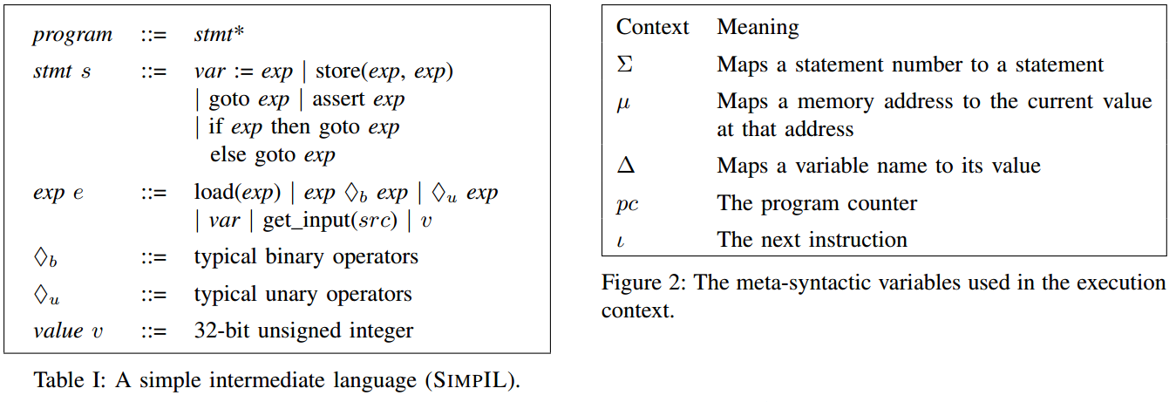
SimpIL (Simple Intermediate Language)
General language for symbolic execution / taint analysis http://users.ece.cmu.edu/~ejschwar/papers/oakland10.pdf

Slide 33
How SimpIL works
Program = sequence of numbered statements
statements = assignments, assertions, jumps, and conditional jumps
if (x <1)
x = 0;
if (blah)
foo();
return();

Slide 34
How SimpIL works
Expressions are things that have no side-effects (i.e. do not change the program state).

Slide 35
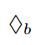
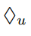
How SimpIL works
= These are binary operators:
+, -, /, *, ^, &(bitwise and), …
Not to be confused with bitwise operators
= These are unary operators:
!, ++, --, &(address of), *(indirection), ~(one’s compliment), type-casts, sizeof()
See: http://en.wikipedia.org/wiki/Unary_operation#C_family_of_languages

Slide 36
SimpIL (Simple Intermediate Language)
General language for symbolic execution / taint analysis http://users.ece.cmu.edu/~ejschwar/papers/oakland10.pdf

Slide 37
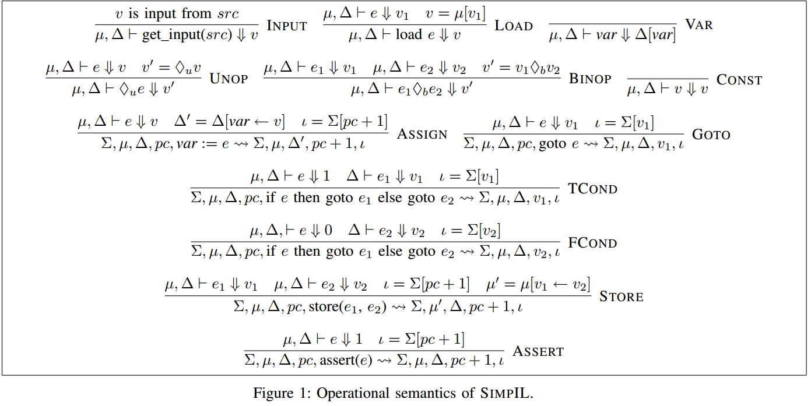
SimpIL (Simple Intermediate Language)

Slide 38
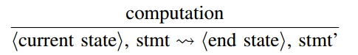
Lets see an example
Following (http://users.ece.cmu.edu/~ejschwar/papers/oakland10.pdf)
Assume 32 bit int values
assume everything is well-typed (type checking is omitted)

Slide 39
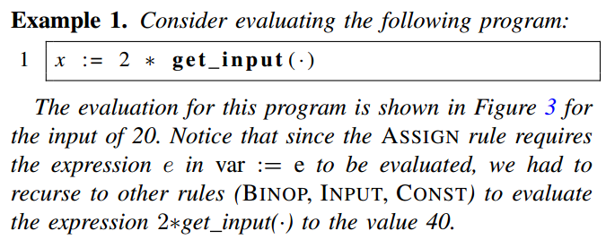
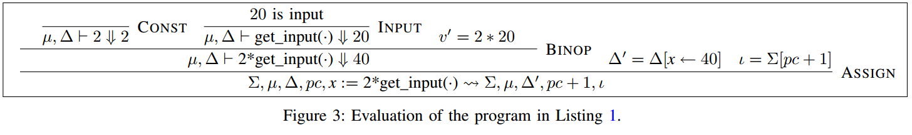
Simple right?
(This won’t be on the exam)

Slide 40
Symbolic Execution
+ code coverage
+ concolic techniques
- heavyweight
- complicated!
- not always worth it

Slide 41
Recent publications / State of the Art

Slide 42
“Adaptive Random Testing” (~2004)
http://www.utdallas.edu/~ewong/SYSM-6310/03-Lecture/02-ART-paper-01.pdf
distributes test cases more evenly in test space
outperforms ordinary random testing
Widely cited paper
great discussion of it here http://blog.regehr.org/archives/1039

Slide 43
“Adaptive Random Testing” (~2004)
http://www.utdallas.edu/~ewong/SYSM-6310/03-Lecture/02-ART-paper-01.pdf
Widely cited paper
great discussion of it here http://blog.regehr.org/archives/1039
Talks about quality of constraints, and how to distribute test cases.

Slide 44
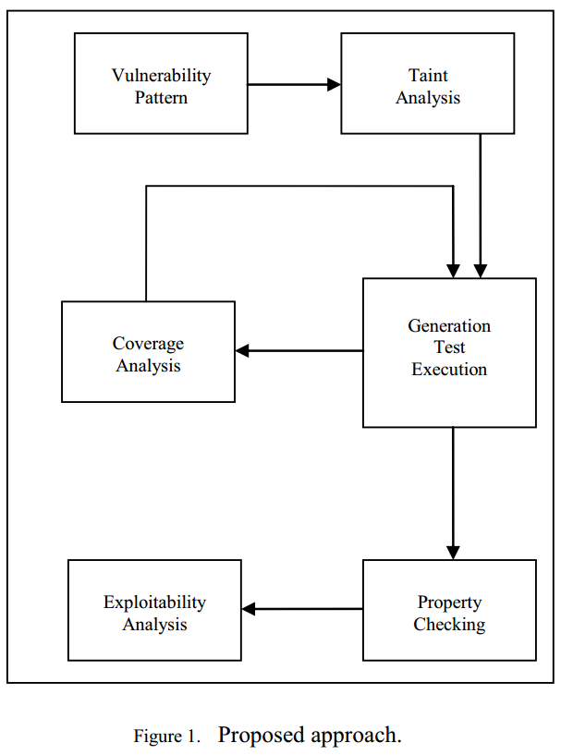
“Smart” Fuzzing
“A Taint Based Approach for Smart Fuzzing” (VUPEN & Grenoble University)
http://diyhpl.us/~bryan/papers2/paperbot/e15bb28f0dc692c053f64bb48b879ab3.pdf
use taint analysis to judge code coverage, and fuzzing efficiency
differentially adjust fuzzing to improve coverage
depending on how many path constraints have been exhausted

Slide 45
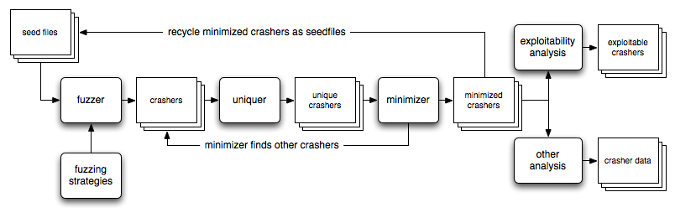
Advancements / State of Art
“Rocket Propelled Chainsaw”

Slide 46
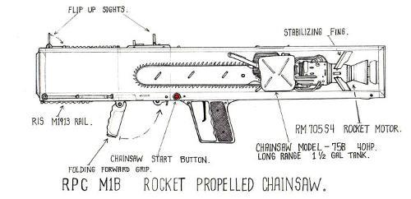
Advancements / State of Art
“Rocket Propelled Chainsaw”

Slide 47
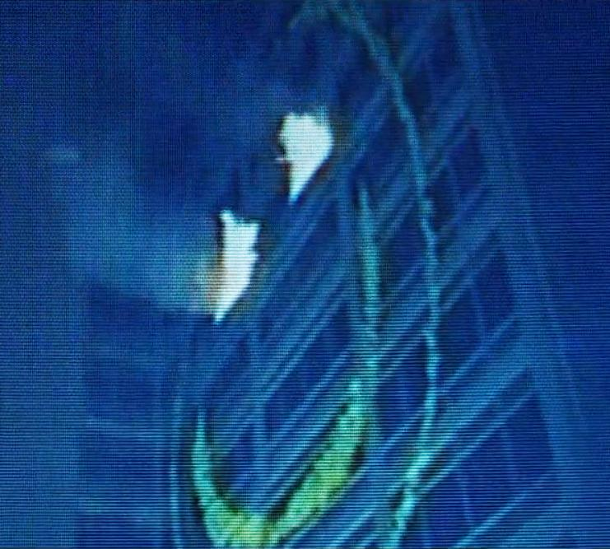
Advancements / State of Art
“Unleashing MAYHEM on Binary Code”
http://www.cse.psu.edu/~tjaeger/cse597-s13/docs/binary_mayhem_oakland_12.pdf
found 1200 bugs (http://lwn.net/Articles/557055/)
29 published 0-days
novel hybrid symbolic execution

Slide 48
(other) Advancements / State of Art
given target code chunk, “bubbles” back up the code paths to determine if reachable and how.
can’t remember who / what :(

Slide 49
GDSL Toolkit: Advancement in IRs
http://www2.in.tum.de/bib/files/simon14gdsl.pdf
Great discussion on IR existing work and pitfalls.
most only cover a subset of instruction set (e.g. x86)

Slide 50
DISCLAIMER on State of Art
This by no means is a comprehensive coverage of the “state of the art” of fuzzing, DTA, forward symbolic execution, etc...

Slide 51

Questions?
Read: Differential Testing for Software (http://www.cs.dartmouth.edu/~mckeeman/references/DifferentialTestingForSoftware.pdf)
Read: Attaching the Rocket to the Chainsaw https://www.cert.org/blogs/certcc/2013/09/putting_the_rocket_on_the_chai.html

Slide 52
BFF
Basic Fuzzing Framework (Linux / Mac)
http://www.cert.org/vulnerability-analysis/tools/bff.cfm

Slide 53
FOE
Failure Observation Engine (Windows fuzzing)
http://www.cert.org/vulnerability-analysis/tools/foe.cfm

